Slide 1
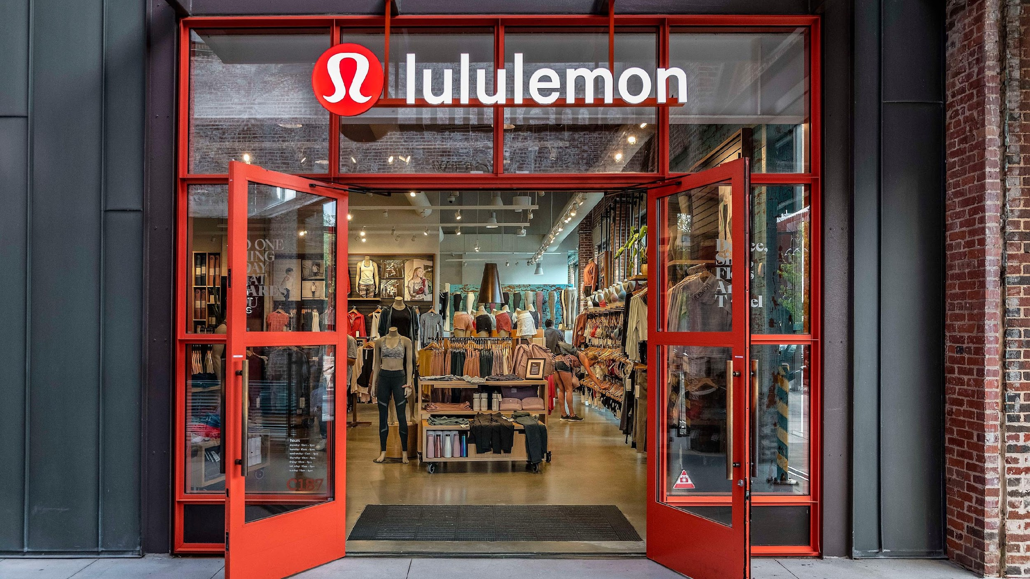

Slide 2

INTRODUCTION Lululemon is a Canadian athletic apparel retailer renowned for its high-quality yoga and activewear clothing. Lululemon's major business lines encompass apparel, accessories, and footwear. Lululemon's primary profit driver has been its apparel segment, fueled by innovative designs, and high-quality fabrics appealing to its core customer base. Lululemon's optimistic outlook is driven by its continuous innovation in product development, expansion into new markets, online sales focus, and efforts to diversify its product offerings. And

Slide 3
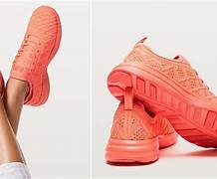

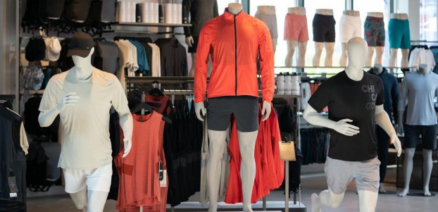
LULULEMON BUSINESS LINE
Yoga and Athletic Apparel
Men's and Women's Collections
Athleisure
Footwear
Online Sales
Retail Stores
Fitness and Community Initiatives

Slide 4
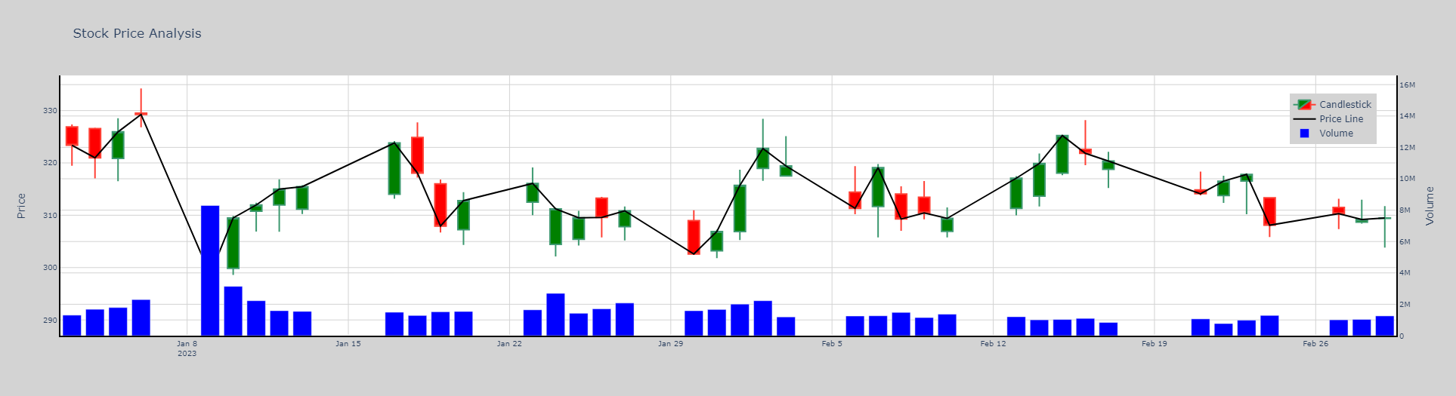
Lululemon stock price history

Slide 5




Competitors

Slide 6
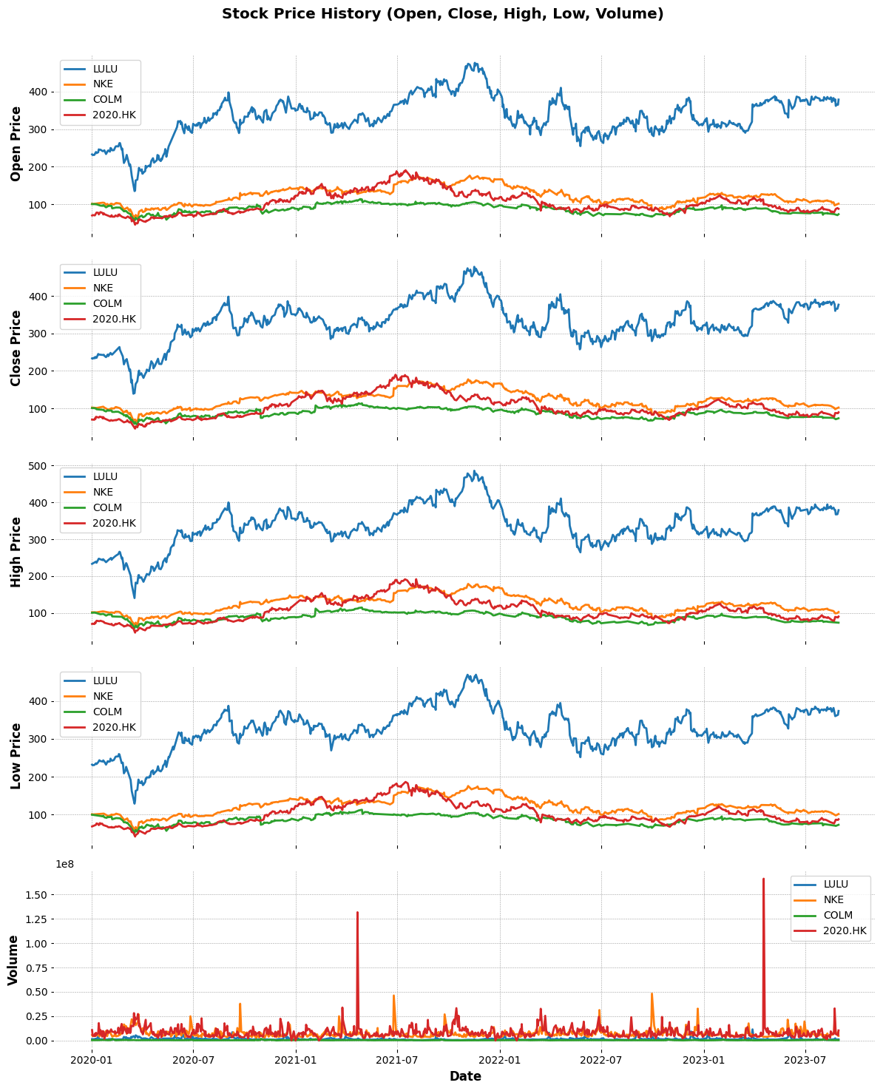
Stock price history comparison with competitors

Slide 7
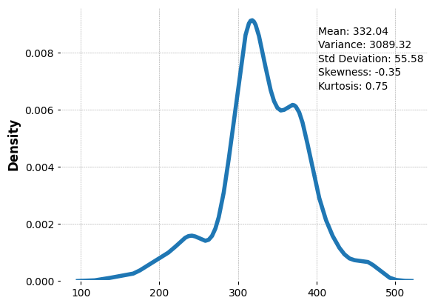
Statistical Analysis of Lululemon
Mean (Average) : 332.04
Standard Deviation (Measure of Spread) : 55.58
Skewness (Measures asymmetry of Data Distribution) : -0.35
Kurtosis (Spikiness): 0.75

Slide 8

Kernel Density Estimation
Kernel density estimation (KDE) is the application of kernel smoothing for probability density estimation, i.e., a nonparametric method to estimate the probability density function of a random variable based on kernels as weights. KDE answers a fundamental data smoothing problem where inferences about the population are made, based on a finite data sample.

Slide 9
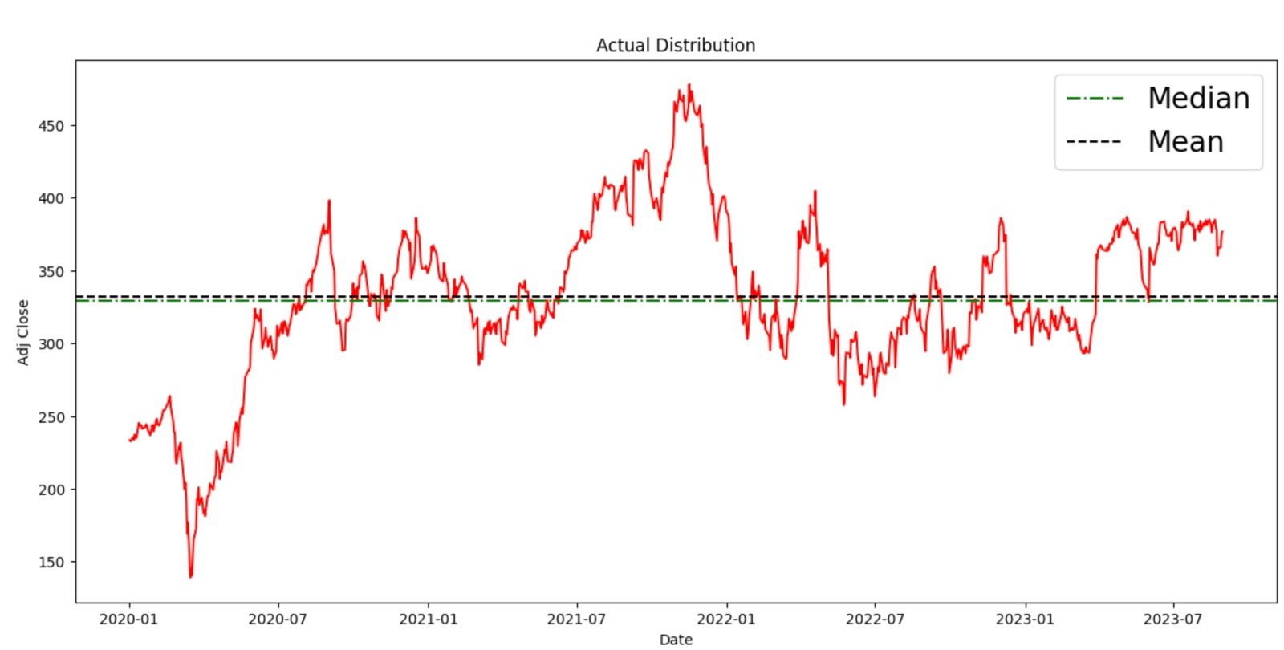
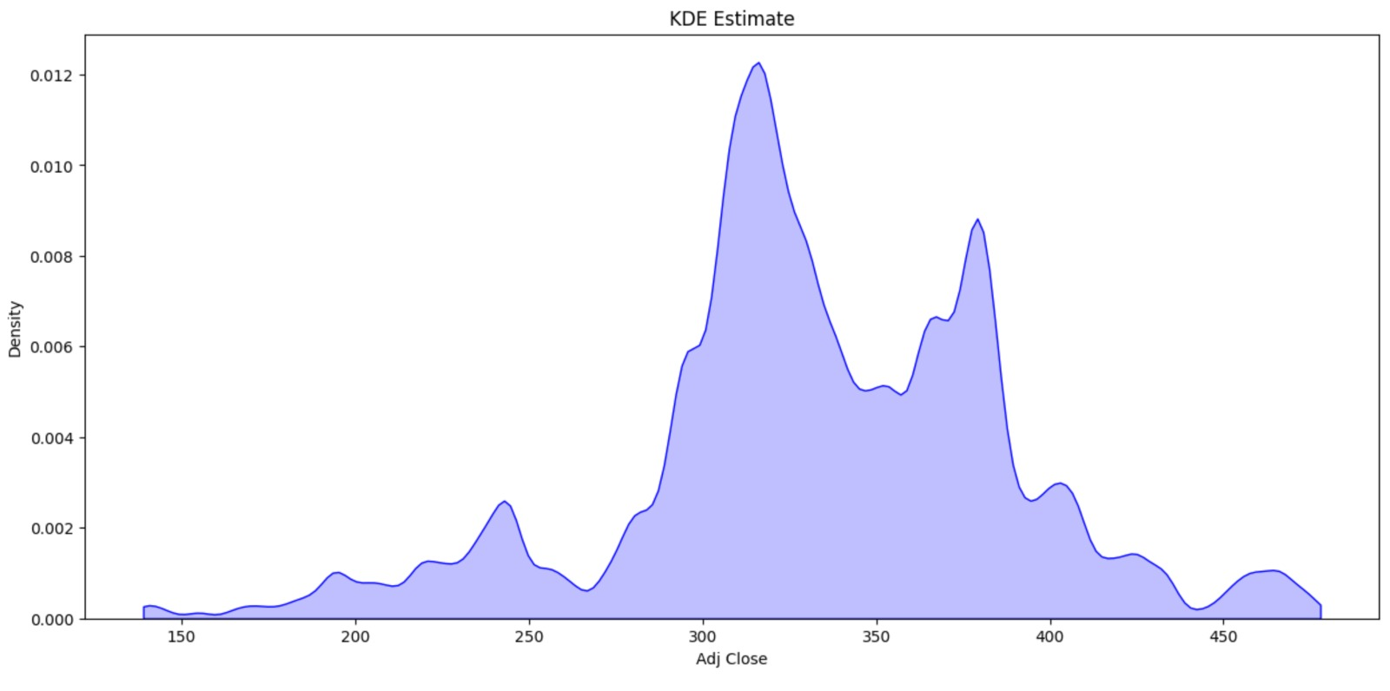
LULULEMON– Actual Distribution vs KDE Estimate
Multimodal distribution for Lululemon, The peak price in the period is close to $450, and lowest price is around $150.
Due to the multimodal nature of the KDE estimate, the bandwidth parameter is lowered to capture different peaks.
The mean value of the stock price during this period is around $335 and the median value is around $330.the

Slide 10

Model feature selection
To choose relevant features with high importance we ran various models like RandomForest, LARS, Ridge Regression, Decision Trees, and XGBoost.
While some of the features were consistently on the top for LULULEMON ( like OBB factors), other features came up as important only in certain models

Slide 11

Features used in models:

Slide 12
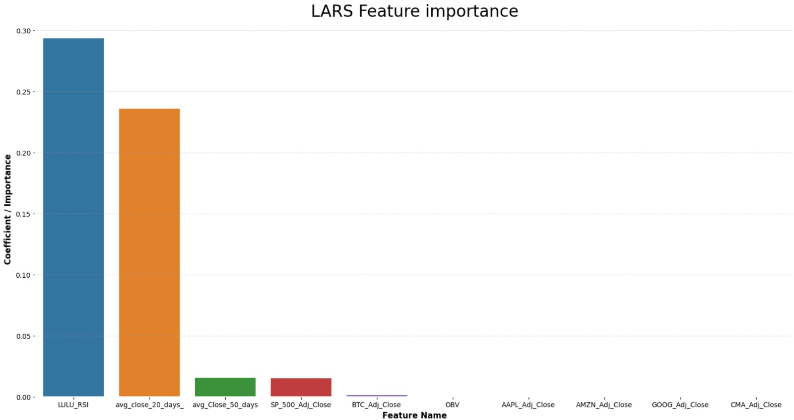
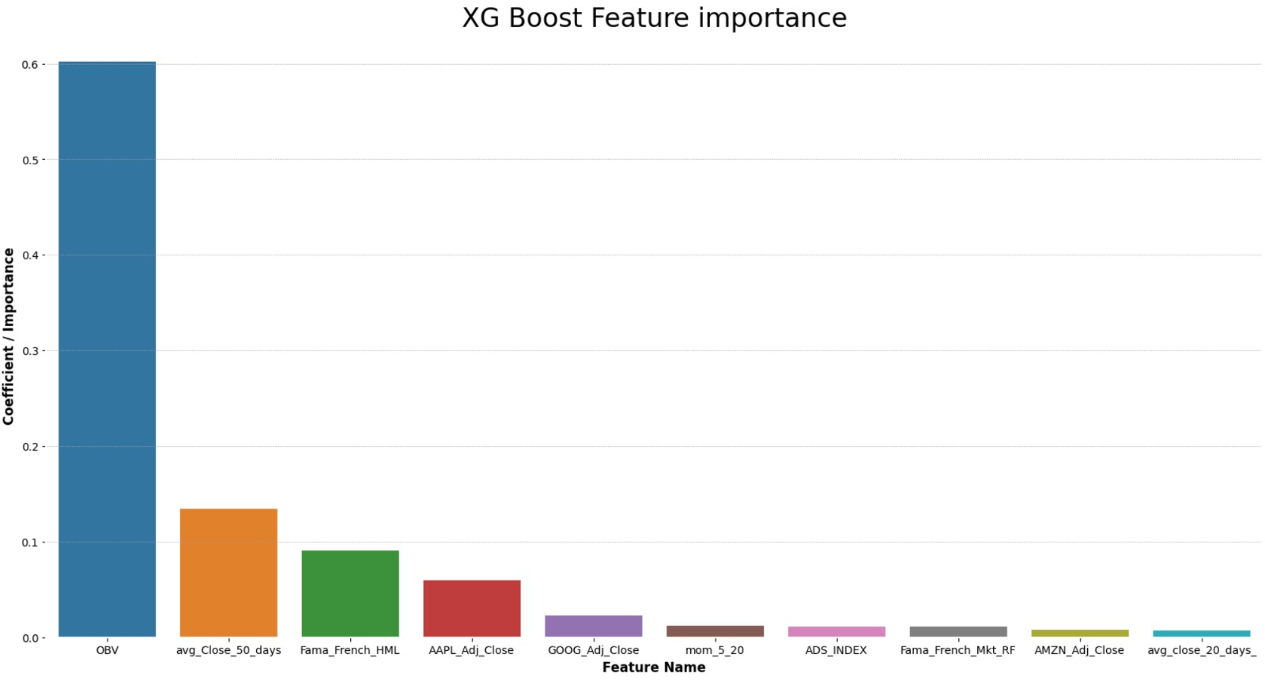
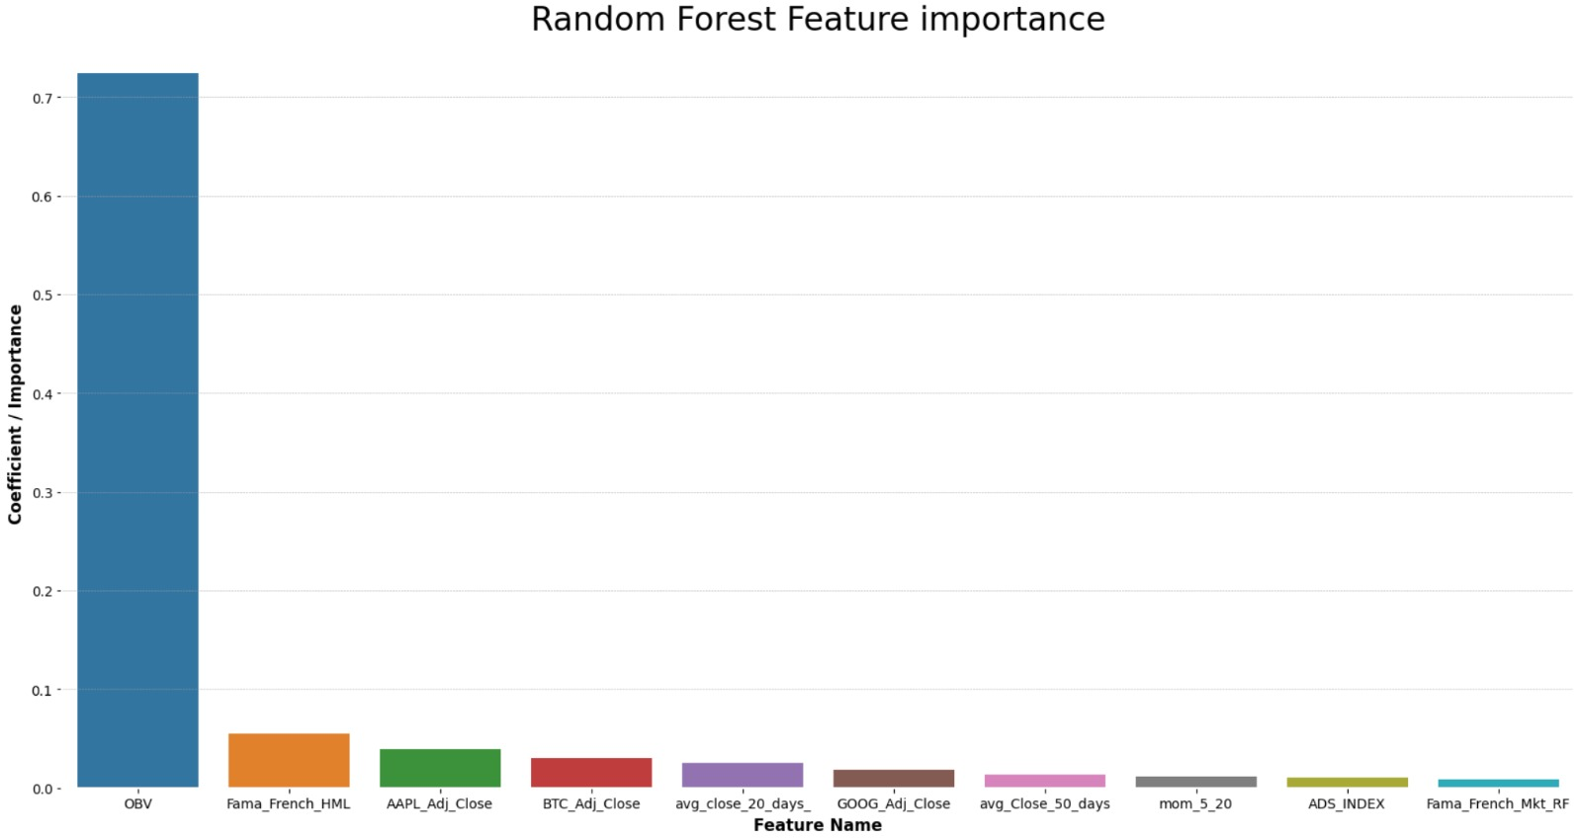
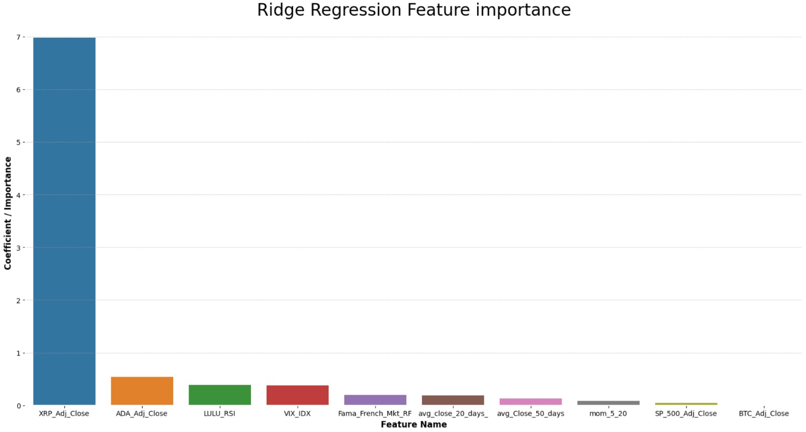
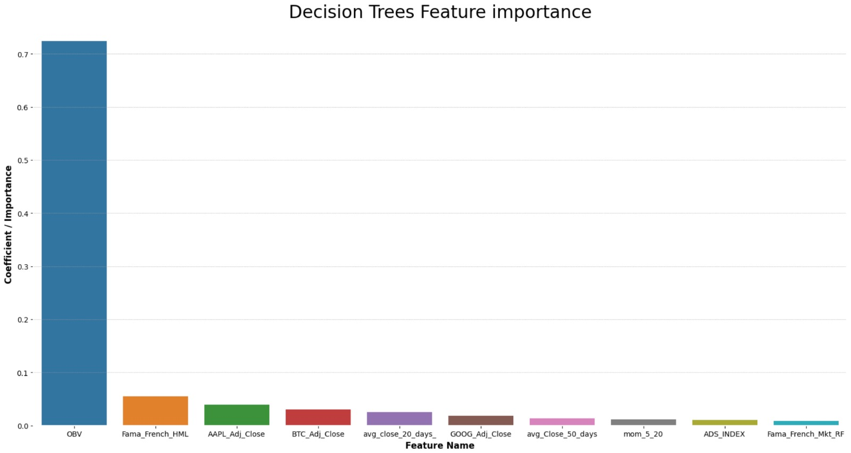
Feature Importance plots
While running different machine learning models, Momentum factors regularly stood out at the top.
We decided to set a threshold and pick the top 3 feature from every model for a total of 8 features (set union)

Slide 13

The 8 final features for training our models:

Slide 14
Applying Statistical Models on LULULEMON Stock

Slide 15
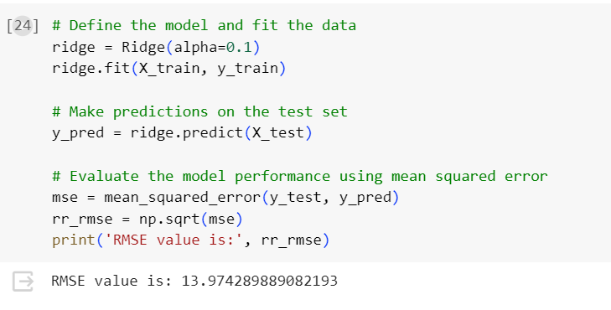
Ridge Regression Prediction

Slide 16
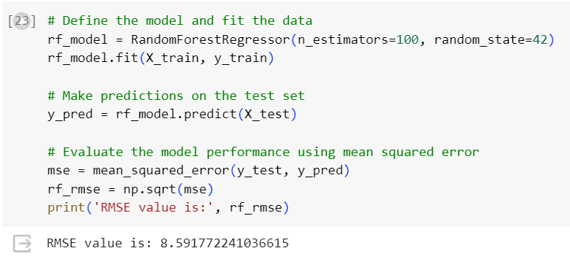
Random Forest Regression Prediction

Slide 17
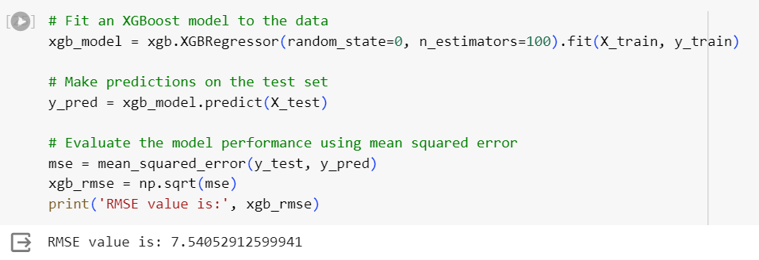
Gradient Boosting(XGBoost) Regression Prediction

Slide 18
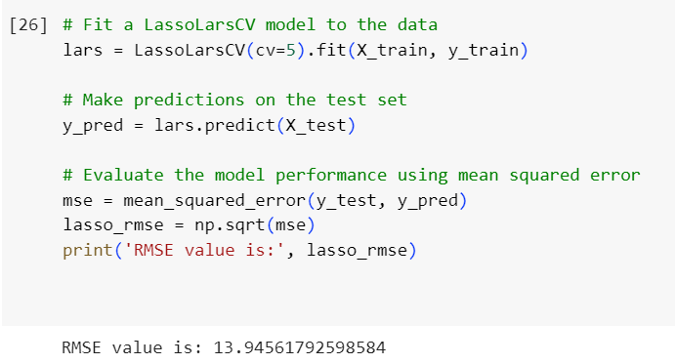
Lasso Regression Prediction:

Slide 19
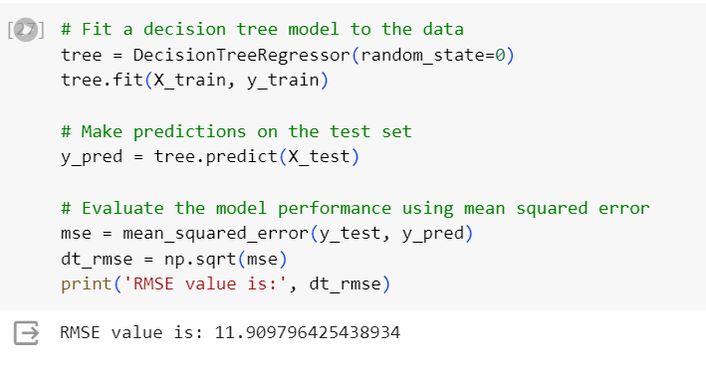
Decision Tree Regression Prediction:

Slide 20
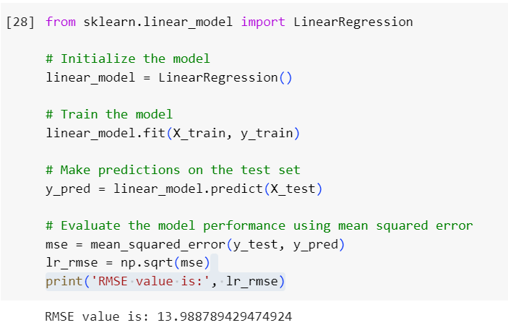
Linear Regression Prediction:

Slide 21
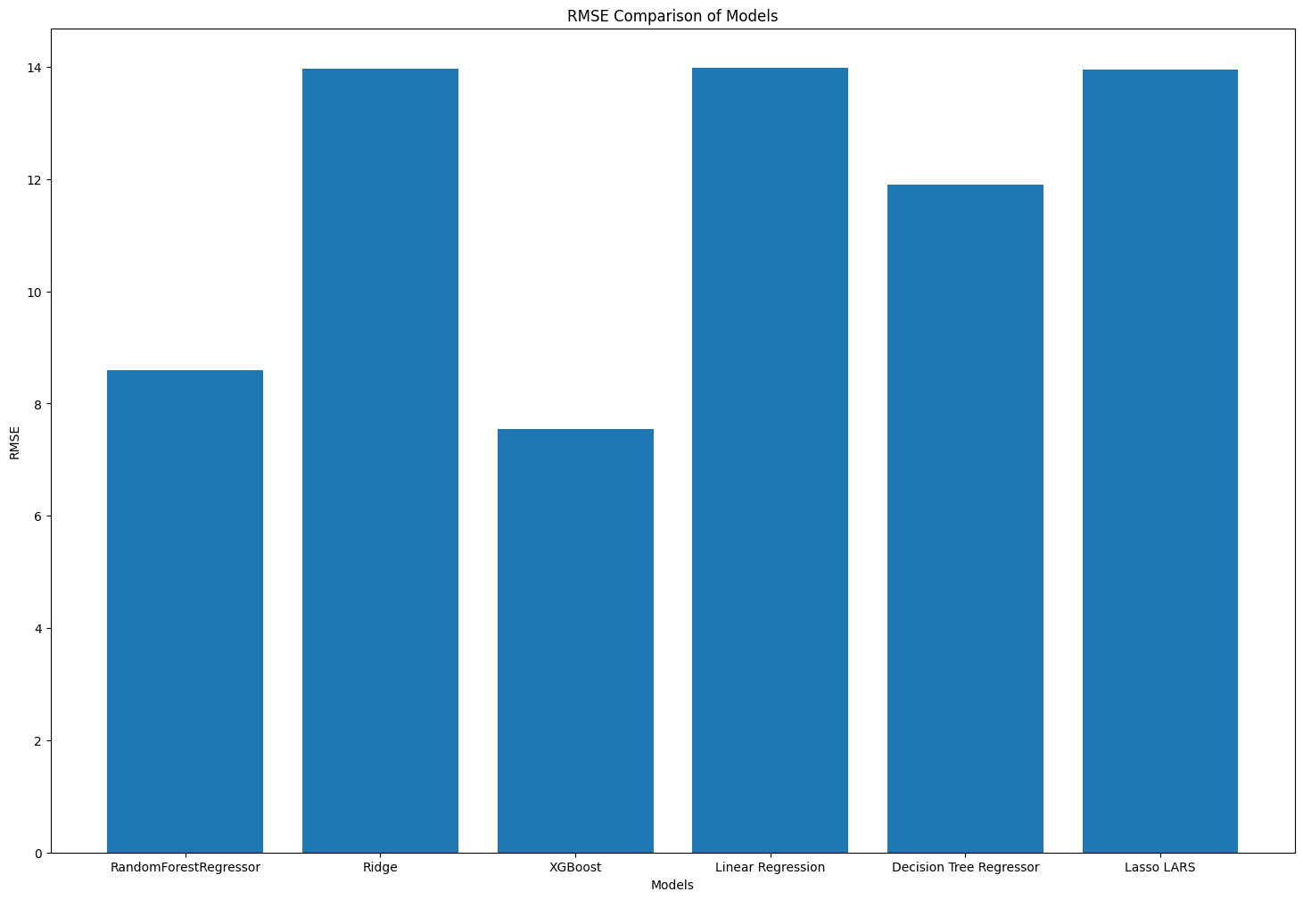
Comparative Graph RMSE of all the models:

Slide 22
Benchmark: GARCH
Generalized Autoregressive Conditional Heteroskedasticity
It is a statistical model used to analyze the volatility of financial time series data

Slide 23
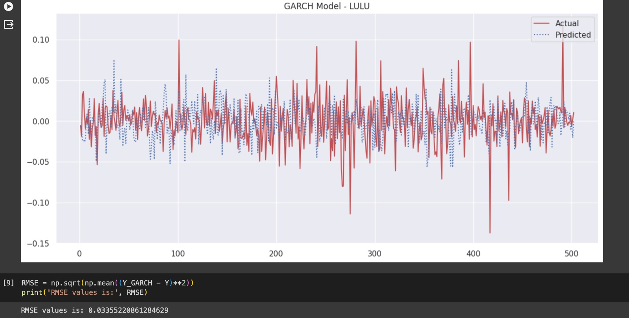

Slide 24
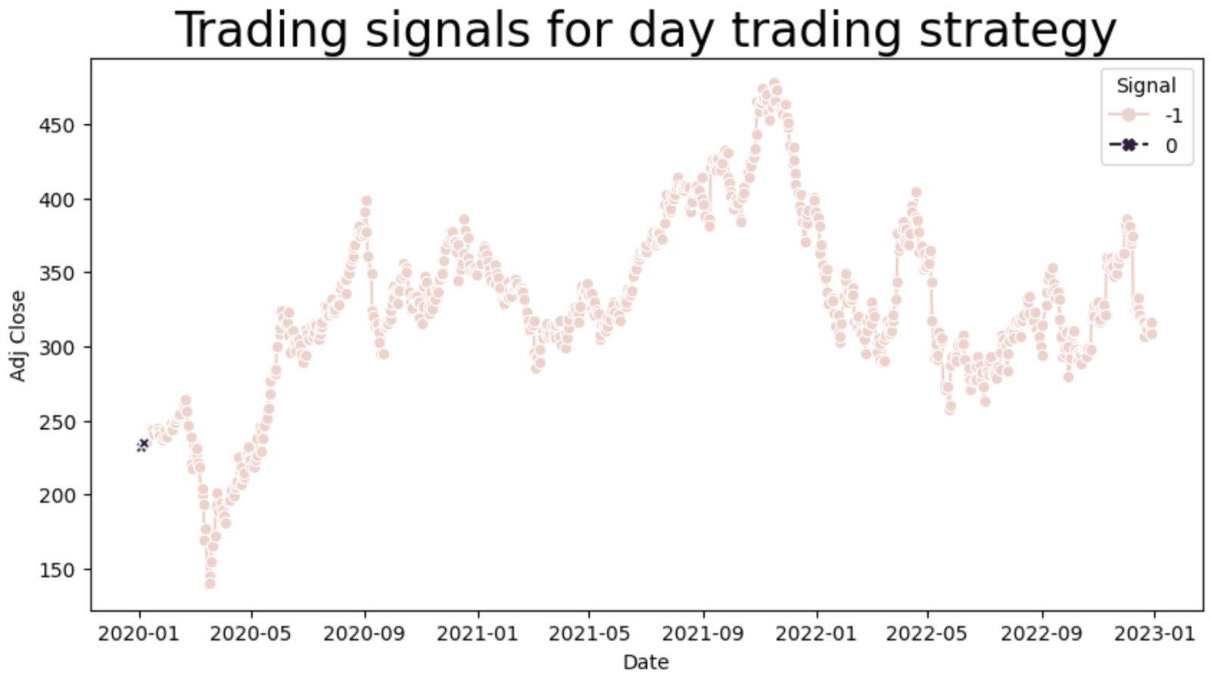
Benchmark: Kalman Filter
​
A mathematical algorithm that uses a series of measurements observed over time, containing statistical noise and other inaccuracies, to estimate the underlying state of a system.​
Combine predictions based on the system model with measurements to obtain an optimal estimate of the system state.​
Two steps: prediction step & and update step​

Slide 25

Thank You

